Slide 1
Slide 6
Files
Dasar-Dasar Pemrograman 1
Semester Ganjil 2016/2017

Slide 2
String formatting, better printing
So far, we have just used the defaults of the print function
We can do many more complicated things to make the output “prettier” and more readable
The basic form of the format method is:
  “format string”.format(data1, data2, ….)
Dasar-Dasar Pemrograman Ganjil 2016-2017

Slide 3
String formatting, better printing (1)
Everything in that format string will be reproduced exactly in the new string (same spacing, same character), with one important exception
The programmer can insert special character sequences, enclosed in braces({}), in the format string that indicate a kind substitution that should occur at that position in the new string
The substitution is driven by the arguments provided in the format method. The objects in the arguments will be placed in the new string at the indicated position, as well as how it will be placed in the string at that position
After substituting the formatted data into the new string, the new string is returned
Dasar-Dasar Pemrograman Ganjil 2016-2017

Slide 4
Format command
Each {} can include format commands that provide directives about how a particular object is to be printed
The four pieces of information that one can provide for a particular object are an alignment indicator, a width number, a precision descriptor, and a type descriptor
The general structure of the most commonly used parts of the format command is:
  {:[align][minimum width][.precision][type]}
  where the square brackets, [], indicate optional arguments
Dasar-Dasar Pemrograman Ganjil 2016-2017

Slide 5
Format command (1)
align is optional (default: left for string, right for numeric)
width is how many spaces (default just enough)
.precision is for floating point rounding (default: no rounding)
type is the expected type (error if the argument is the wrong type)
Dasar-Dasar Pemrograman Ganjil 2016-2017

Slide 6
Format command (2)
Alignment
< | Left
> | Right
^ | Center
type
s | String
c | Character
d | Decimal integer
b | Binary
X | Hexadecimal
f | Floating-point decimal
e | Floating-point exponential
% | Floating-point as percent
Dasar-Dasar Pemrograman Ganjil 2016-2017

Slide 7
Example
print(‘{:>10s} is {:<10d} years old.’.format(‘Bill’,25))
Output:
Bill is 25 years old.
String 10 spaces wide including the object, right justified (>)
Decimal 10 spaces wide including the object, left justified (<)
10 spaces
10 spaces
Dasar-Dasar Pemrograman Ganjil 2016-2017

Slide 8
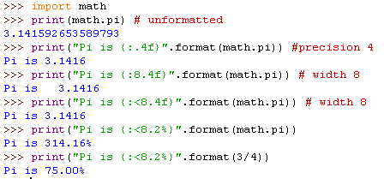
Floating point precision
Can round floating point numbers to specific number of decimal places
Dasar-Dasar Pemrograman Ganjil 2016-2017

Slide 9
Exercise
Print integer 0 to 15 with their respective power square value with format:
  <integer, align left 3 spaces> → <pow square, align right 10 spaces>
Dasar-Dasar Pemrograman Ganjil 2016-2017

Slide 10
What is a file?
A file is a collection of data that us stored on secondary storage like a harddisk or a flashdisk
Accessing a file means establishing a connection between the file and the program and moving data between the two
Dasar-Dasar Pemrograman Ganjil 2016-2017

Slide 11
Two types of files
Text files
  A text file is organized as Unicode/ASCII data and is generally human readable
Binary files
  A binary file is organized as a sequence of bytes and is generally not human readable
Dasar-Dasar Pemrograman Ganjil 2016-2017

Slide 12
File Objects or Stream
When opening a file, you create a file object or file stream that is a connection between the file information on disk and the program
The stream contains a buffer of the information from the file, and provides the information to the program
If everything is working well, the whole process will be invisible to the programmer
Dasar-Dasar Pemrograman Ganjil 2016-2017

Slide 13



Input-output streams
Executing program
Input stream
Output stream
Input file
Output file
Executing program
Input stream
Output stream
Dasar-Dasar Pemrograman Ganjil 2016-2017

Slide 14
Buffering
Reading from a disk is very slow. Thus the computer will read a lot of data from a file in the hopes that, if you need the data in the future, it will be buffered in the file object in primary memory
This means that the file object contains a copy of information from the file
Dasar-Dasar Pemrograman Ganjil 2016-2017

Slide 15
Making a file object
my_file = open(“kode.txt”, “r”)
my_file is the file object. It contains the buffer of information. The open function creates the connection between the disk file and the object. The first quoted string is the file name on disk, the second is the mode to open it (here, “r” means to read)
Dasar-Dasar Pemrograman Ganjil 2016-2017

Slide 16
Where is the disk file?
When opened, the name of the file can come in one of two forms:
  “file.txt” assumes the file name is file.txt and it is located in the current program directory (folder)
  “c:\fprog\file.txt” is the fully qualified file name and includes the directory information: c:\fprog
Dasar-Dasar Pemrograman Ganjil 2016-2017

Slide 17
Example
Suppose that we have already created a text file named “kode.txt” by using IDLE or another text editor, with the contents of six lines:
From “Nyanyain Kode” by Warkop DKI
Uwe wong bu, aruko
Namidana kodore nariyo
Omoidatsu natsunohi
Yang baju merah jagan sampe lolos
Dasar-Dasar Pemrograman Ganjil 2016-2017

Slide 18

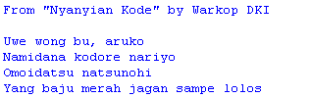
Example
We can open the file “kode.txt” for reading as follows:
Output:
To close the file
  fileStream.close()
Dasar-Dasar Pemrograman Ganjil 2016-2017

Slide 19
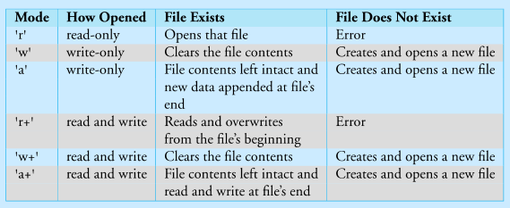
Different modes
Dasar-Dasar Pemrograman Ganjil 2016-2017

Slide 20
Careful with write modes
Be careful if you open a file with the ‘w’ mode. It sets an existing file’s contents to be empty, destroying any existing data
The ‘a’ mode is nicer, allowing you to write to the end of an existing file without changing the existing contents
Dasar-Dasar Pemrograman Ganjil 2016-2017

Slide 21
Text files use strings
If you are interacting with text files (which is all we will do most of the time), remember that everything is a string
  Everything to be read is a string
  When you write to a file, it will be converted to a string
Dasar-Dasar Pemrograman Ganjil 2016-2017

Slide 22

Creating a File for Writing
Once you have created a file object, opened for writing, you can use the print command by adding the argument
  File = <file_object>
Dasar-Dasar Pemrograman Ganjil 2016-2017

Slide 23
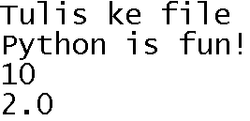
The contents of “myFile.txt”
Dasar-Dasar Pemrograman Ganjil 2016-2017

Slide 24
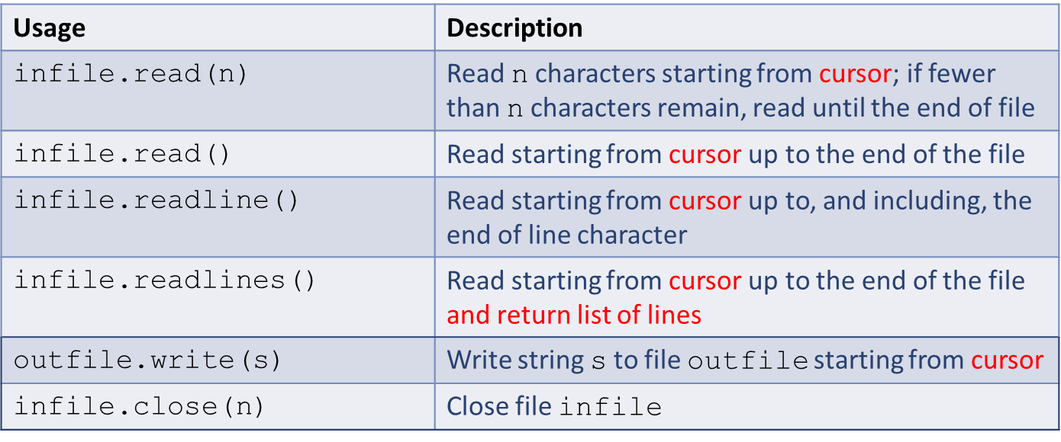
File methods
Methods read() and readline() return the characters read as a string
Method readlines() returns the characters read as a list of lines
Method write() returns the number of characters written
Dasar-Dasar Pemrograman Ganjil 2016-2017

Slide 25
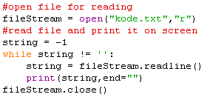
Example
We can open the file “kode.txt” for reading as follows:
Output:
Dasar-Dasar Pemrograman Ganjil 2016-2017

Slide 26
Close a file
When the program is finished with a file, we close the file:
  Flush the buffer contents from the computer to the file
  Shut down the connection to the file
close is a method of a file object
  file_obj.close()
All files should be closed after use
Dasar-Dasar Pemrograman Ganjil 2016-2017

Slide 27
References
William Punch & Richard Enbody. The Practice of Computing using Python, 2nd Edition. Addison-Wesley, 2013
Y. Daniel Liang. Introduction to Programming Using Python. Prentice Hall, 2013.
John Zelle. Python Programming: An Introduction to Computer Science, 2nd Edition. Franklin, Beedle & Associates Inc., 2010.
Mark Lutz. Learning Python, 5th Edition. O’Reilly Media. Copyright 2013 Mark Lutz, 978-1-44-93-5573-9
L. Y. Stefanus. Slide Pelatihan Python. 2015.
Dasar-Dasar Pemrograman Ganjil 2016-2017

